Slide 1
Machine Learning
Presented By
Deepak Sharma

Slide 2
Topics Covered
K Means
Linear Regression
Logistic Regression
Decision Tree
Random Forest

Slide 3
Machine Learning
Unsupervised and Supervised Learning
Machine learning is an application of artificial intelligence (AI) that provides systems the ability to automatically learn and improve from experience without being explicitly programmed.
Unsupervised learning is a type of machine learning algorithm used to draw inferences from datasets consisting of input data without labelled responses.
Supervised learning is inferring from labelled training data.

Slide 4
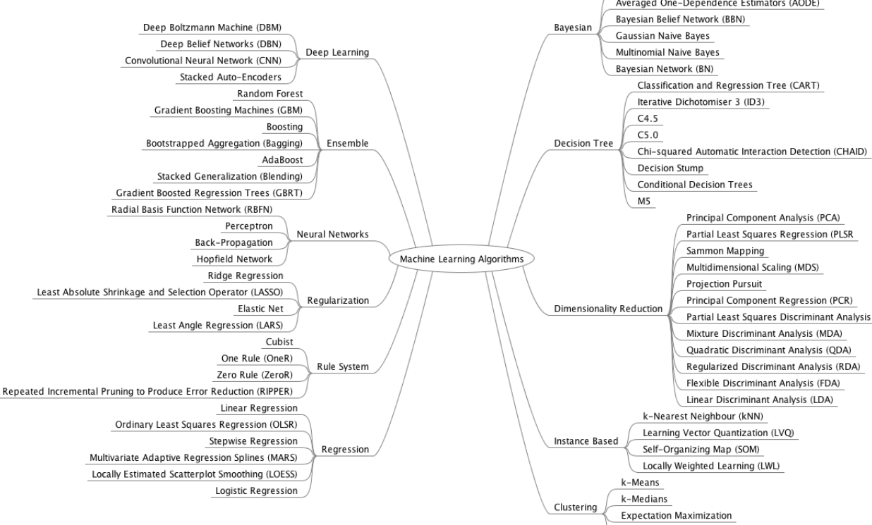

Slide 5
K Means
k-means is one of the simplest unsupervised learning algorithms that solve the well known clustering problem.
The algorithm classify a given data set through a certain number of clusters (assume k clusters) fixed apriori.
Algorithmic steps for k-means clustering
Let X = {x1,x2,x3,……..,xn} be the set of data points and V = {v1,v2,…….,vc} be the set of centers.
1) Randomly select ‘c’ cluster centers.
2) Calculate the eucledian distance between each data point and cluster centers.
3) Assign the data point to the cluster center whose distance from the cluster center is minimum of all the cluster centers..
4) Recalculate the new cluster center
5) Recalculate the distance between each data point and new obtained cluster centers.
6) If no data point was reassigned then stop, otherwise repeat from step 3).

Slide 6
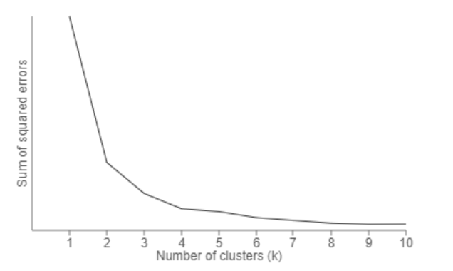
Optimal Value of K - Elbow Method

Slide 7
Advantage of K Means
1) Fast, robust and easier to understand and implement.
2) Gives best result when data set are distinct or well separated from each other.
1) The learning algorithm requires apriori specification of the number of cluster centers.
2) The use of Exclusive Assignment - If there are two highly overlapping data then k-means will not be able to resolve that there are two clusters.
3) Euclidean distance measures can unequally weight underlying factors.
4) The learning algorithm provides the local optima of the squared error function.
Disadvantage of K Means

Slide 8
Business Application
Document Classification - Cluster documents in multiple categories based on tags, topics, and the content of the document.
Customer Segmentation - Clustering helps marketers improve their customer base, work on target areas, and segment customers based on purchase history, interests, or activity monitoring
Insurance Fraud Detection - Utilizing past historical data on fraudulent claims, it is possible to isolate new claims based on its proximity to clusters that indicate fraudulent patterns.
Cyber Profile Criminals -The idea of cyber profiling is derived from criminal profiles, which provide information on the investigation division to classify the types of criminals who were at the crime scene.

Slide 9

Linear Regression
Linear regression is the simplest and most widely used statistical technique for predictive modeling.
It basically gives us an equation, where we have our features as independent variables, on which our target variable is dependent upon.
Linear regression equation looks like
Here, we have Y as our dependent variable (Sales), X’s are the independent variables and all thetas are the coefficients.
Coefficients are basically the weights assigned to the features, based on their importance.
Residuals - The difference between the values predicted by us and the observed values

Slide 10
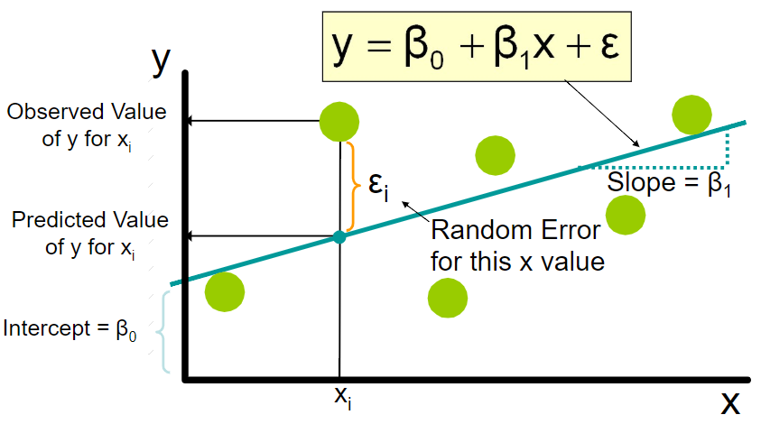
Linear Regression

Slide 11
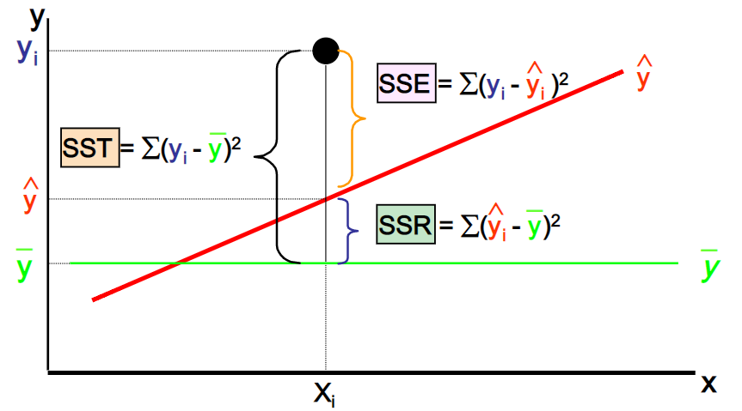
Explained & Unexplained Variation

Slide 12
Key Assumptions of Regression
The regression has five key assumptions:
Linear relationship
Multivariate normality
No or little multicollinearity
No auto-correlation
Homoscedasticity

Slide 13
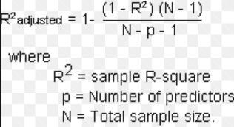
Goodness of Fit
R Square - This statistic indicates the percentage of the variance in the dependent variable that the independent variables explain collectively.
R-squared measures the strength of the relationship between your model and the dependent variable on a convenient 0 – 100% scale.
Adjusted R Square - The adjusted R-squared is a modified version of R-squared that has been adjusted for the number of predictors in the model.
The adjusted R-squared increases only if the new term improves the model more than would be expected by chance.
It decreases when a predictor improves the model by less than expected by chance.

Slide 14
Business Application
A factory manager can create a statistical model to understand the impact of oven temperature on the working of instrument
A call centre can optimize customer handling operation by understanding the impact of number of customers on wait time
A hotel can forecast the number of staff required as per the demand fluctuate

Slide 15
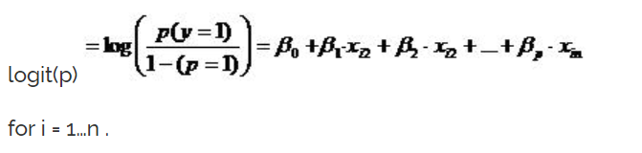
Logistic Regression
It’s a classification algorithm
it predicts the probability of occurrence of an event by fitting data to a logit function.
The logit function is the natural log of the odds that Y equals one of the categories.
The logit function is useful in analytics because it maps probabilities (which are values in the range [0, 1]) to the full range of real numbers.
Mathematically, logistic regression estimates a multiple linear regression function defined as:
this is interpreted as taking input log-odds and having output probability.

Slide 16
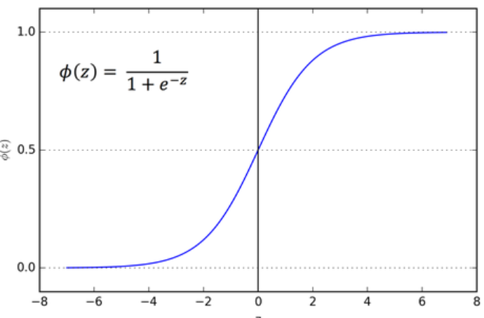
Sigmoid Function
The inverse of the logit function is sigmoid function
It maps the arbitrary real values back to the range [0,1]
It is useful when we need to transform real values into probability

Slide 17
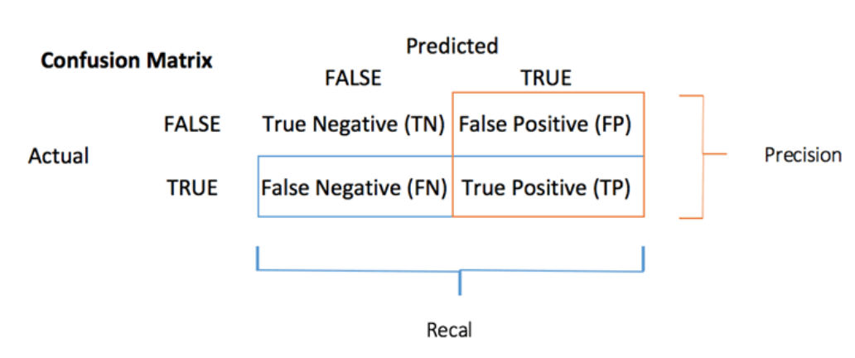
Model Validation
Confusion Matrix

Slide 18
Sensitivity Vs Specificity
Confusion Matrix
Sensitivity, recall, hit rate and True Positive Rate = TP/P
Specificity, selectivity, and True Negative Rate = TN/N
Precision or Positive Predictive Value = TP/(TP+FP)

Slide 19
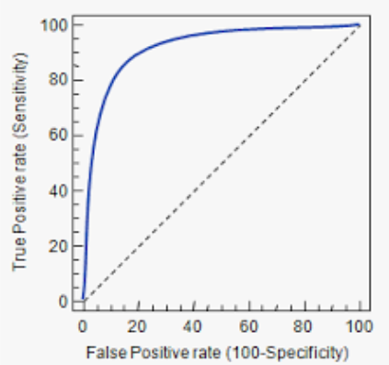
ROC -Receiver Operating Characteristics
The ROC curve shows the true positive rate (i.e., recall) against the false positive rate.
The False Positive Rate is the ratio of negative instances that are incorrectly classified as positive. It is equal to one minus the true negative rate.
Specificity - The True Negative rate is called specificity
The ROC curve plots sensitivity (recall) versus 1-specificity

Slide 20
Decision Tree
Decision tree is a type of supervised learning algorithm (having a pre-defined target variable) that is mostly used in classification problems. It works for both categorical and continuous input and output variables.
Categorical Variable Decision Tree: Decision Tree which has categorical target variable then it called as categorical variable decision tree. Example:- In above scenario of student problem, where the target variable was “Student will play cricket or not” i.e. YES or NO.
Continuous Variable Decision Tree: Decision Tree has continuous target variable then it is called as Continuous Variable Decision Tree.

Slide 21
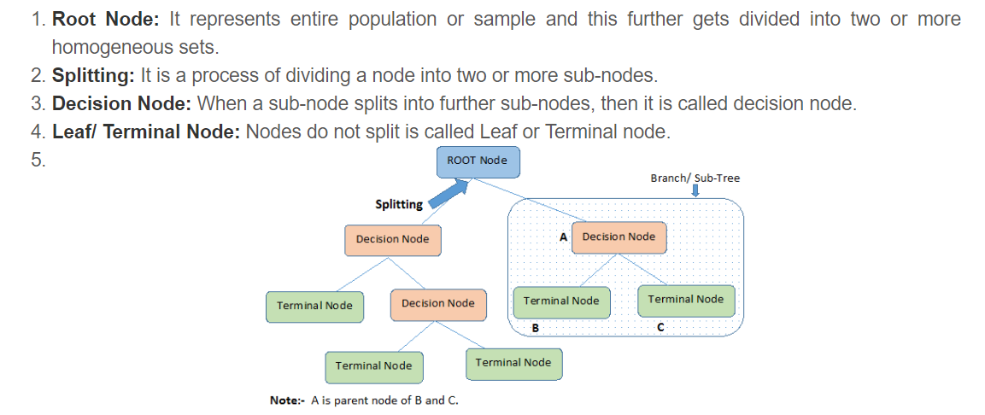
Terminology Used in Decision Tree

Slide 22
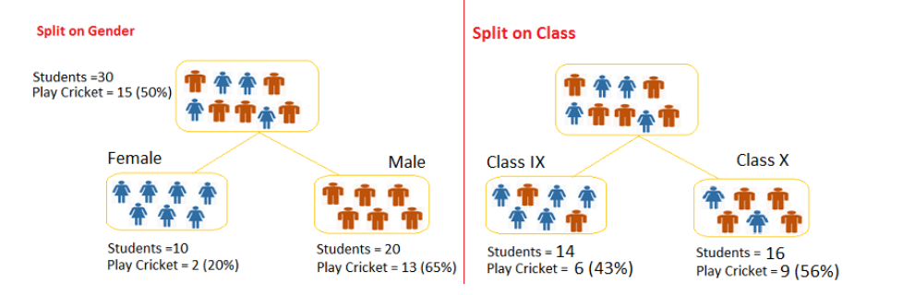
How does a tree decide where to split?
Gini Index - if we select two items from a population at random then they must be of same class and probability for this is 1 if population is pure.
It works with categorical target variable “Success” or “Failure”.
It performs only Binary splits
Higher the value of Gini higher the homogeneity.
CART (Classification and Regression Tree) uses Gini method to create binary splits.

Slide 23
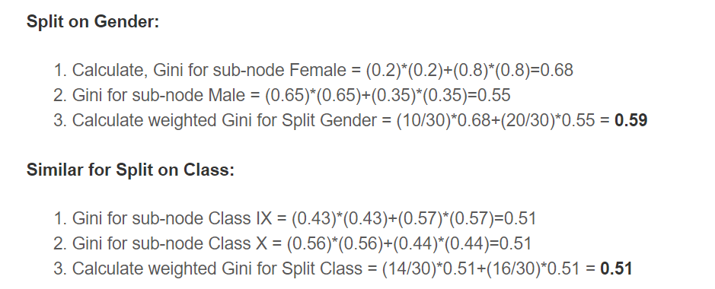

Slide 24

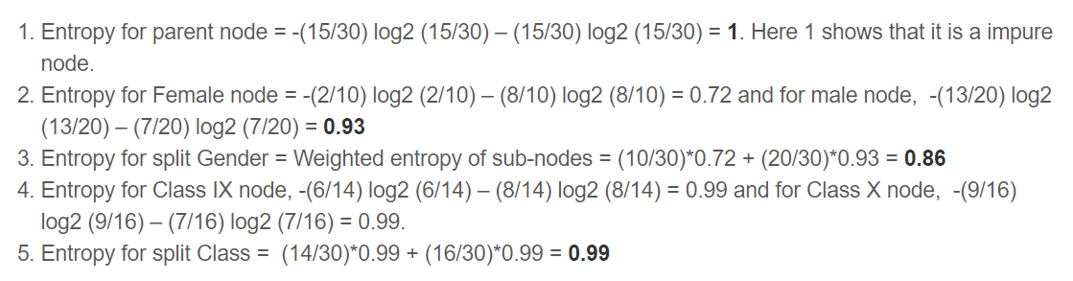
Information Gain
How much information is required to explain the disorganisation in the system
Here p and q is probability of success and failure respectively in that node.
Entropy

Slide 25
Advantage of Decision Tree
Easy to Understand
Useful in Data exploration
Less data cleaning required
Over fitting
Not fit for continuous variables
Disadvantage of Decision Tree

Slide 26
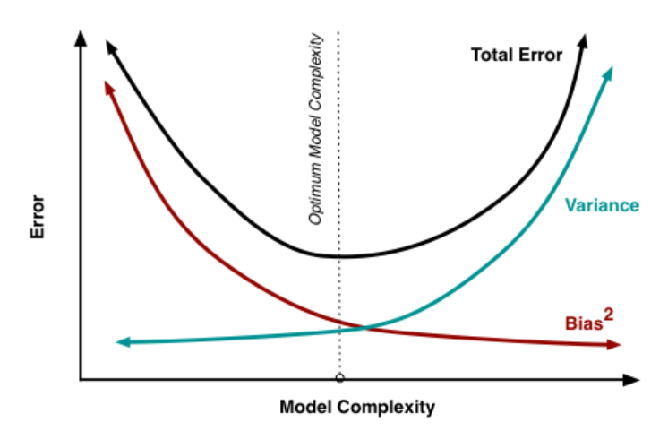
Bias-Variance Tradeoff

Slide 27
Ensemble
Ensemble methods is a machine learning technique that combines several base models in order to produce one optimal predictive model
Bagging - Here idea is to create several subsets of data from training sample chosen randomly with replacement.
Now, each collection of subset data is used to train their decision trees. As a result, we end up with an ensemble of different models. Average of all the predictions from different trees are used
Boosting - In this technique, learners are learned sequentially with early learners fitting simple models to the data and then analyzing data for errors.
Types of Ensemble Method

Slide 28
Random Forest
Random Forest is an extension over bagging.
It takes one extra step where in addition to taking the random subset of data, it also takes the random selection of features rather than using all features to grow trees.
Handles higher dimensionality data very well.
Handles missing values and maintains accuracy for missing data.
Since final prediction is based on the mean predictions from subset trees, it won’t give precise values for the regression model.
Advantages of Random Forest
Disadvantages of Random Forest

Slide 29
Thank You

